Slide 1
Valuation
One Method: Discounted Cash Flow approach

Slide 2
What drives value?
Revenue Growth
Gross Margin
Operating Margin
Tax Rate
Investments in Capital (Fixed and Working Capital)

Slide 3
Valuation via Discounted Cash Flows (DCF)
The Value of the company is the present value of all of the Future net Free Cash Flow (FCF)
At an appropriate discount rate (a dollar 3 years from now is not worth a dollar today).
Value to the owners is Present Value of Future FCF less outstanding loans.

Slide 4
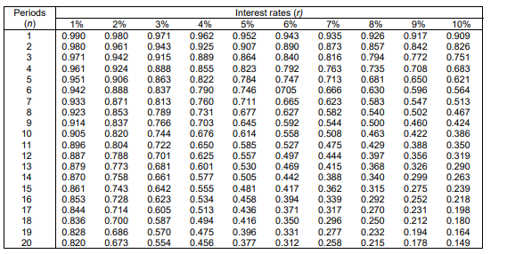
Present Value Table

Slide 5
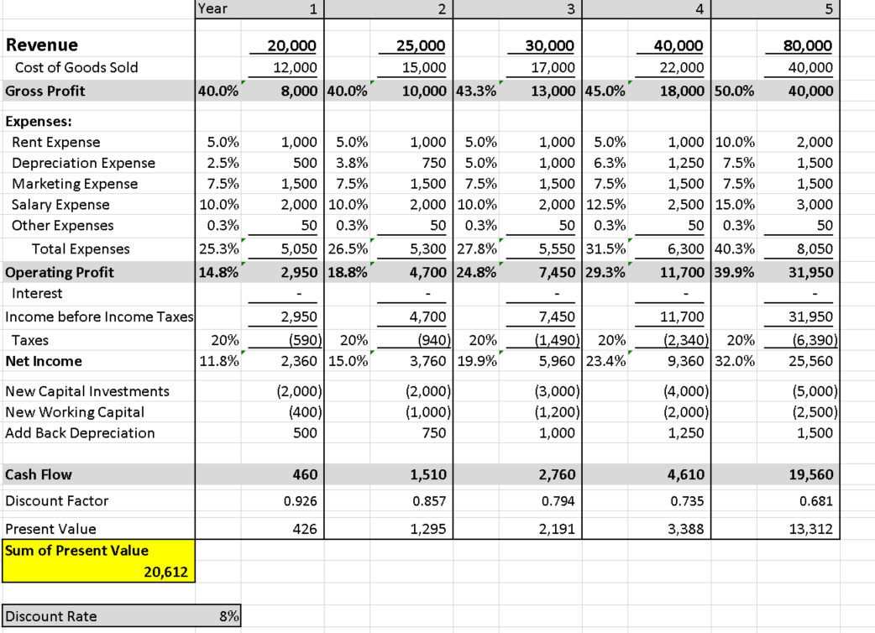
DCF Model – 5 year Forecast

Slide 6
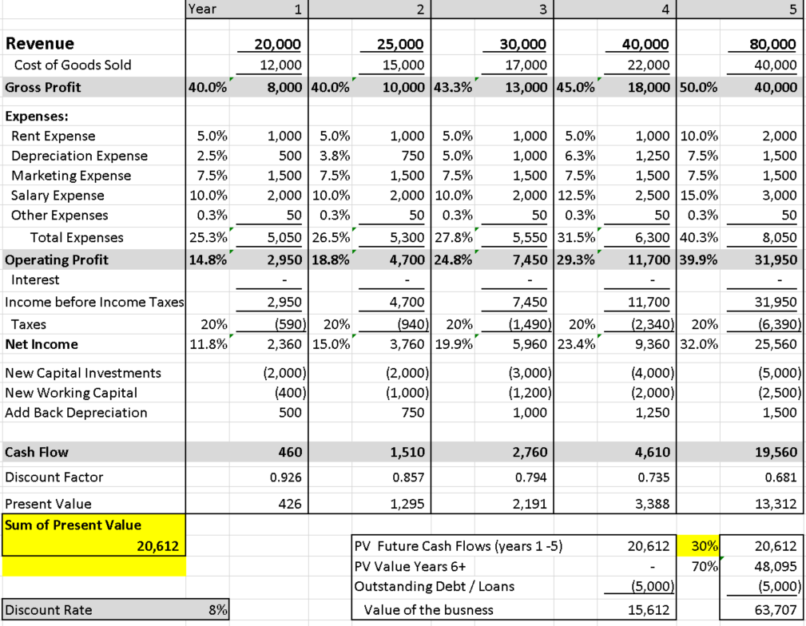
What to do about the years beyond the Forecast?

Slide 7
