Slide 1
Small Business Legal Overview
Priya Lane
Lawyers for Civil Rights

Slide 2
Small Group Activity 1:
Work with your group to come up with a business concept and a name for a new small business.

Slide 3
Entity Formation

Slide 4
Default Business Structure: Sole Proprietorship
Default status for individual conducting business
Owner and business are one and the same
Owner alone has control and decision making authority
The business is not a separate entity for tax purposes
  Income is taxed to the owner in the year that the business received it
Pro
  Few Formalities
Cons
  Unlimited personal liability
  Business terminates upon the owner’s death - can not transfer ownership

Slide 5
Default Business Structure: General Partnership
Formed through regular course of conduct of 2 or more individuals and/or by entering into a written partnership agreement
Partners share control and decision-making authority
One partner’s actions and agreements bind the other partner(s)
“Pass through” taxation, but requires partnership to file a separate tax return
Pro
  Few Formalities
Cons
  Unlimited personal liability
  Ownership not readily transferable
  Elimination of a partner (e.g. death) constitutes automatic dissolution of the partnership

Slide 6
What to consider when forming a legal entity?
Liability
Taxation
Management
Continuation
Notes:
Entity refers to the structure of your business-- a corporation like AT&T is an entity. And these are the four main things that should be considered when choosing an entity– we will go over the in more detail.

Slide 7
What is Liability?
Financial Responsibility in case of lawsuit
  Obligations under contracts (verbal or written) - including contracts to deliver goods or services, loan documents, lease agreements, etc.
  Injury or damage to persons or property
If the business is held liable, all of the personal assets (home, car, bank account, etc) could be reached in payment of liability

Slide 8
How to protect against liability
Homestead Act
Insurance
Use of a Limited Liability Entity
  Except in rare cases, only the assets of the entity would be at risk
  Must form and maintain and always conduct business in the name of the entity.

Slide 9
Limited Liability Entity: Corporations
Separate legal entity formed by one or more individuals under state law
Shareholders, directors, officers
Limited Liability for shareholders (owners)
Easy to transfer ownership
Formalities: Articles of Organization and Bylaws
Dual Level of Taxation (except in case of S-corporation)
  Corporation pays taxes on income, then shareholders pay taxes on dividends

Slide 10
Limited Liability Entity: S-Corporations
Makes “s-election” with IRS (~2.5 months)
“Pass-Through” taxation
Corporation itself does not pay taxes, but files informational tax return
Shareholders/investors must be US citizen or resident
Corporation must withhold wages paid to employee/owner
Only individuals may be owners
Individuals must be either US citizens or permanent residents
No more than 100 owners
Only one class of stock

Slide 11
Limited Liability Entity: Corporation
File Articles of Organization with Secretary of Commonwealth
$250 minimum filing fee
$100 annual report filing fee
Minimum corporate excise tax due each year (approximately $450)
Penalty: If corporation does not file annual report and/or pay excise taxes for two or more years, Secretary of Commonwealth may dissolve it

Slide 12
Limited Liability Entity: LLC
Separate legal entity formed by one or more individuals
Flexibility in the rights of owners and how the company will be controlled
“Pass-through” tax treatment
A single-member LLC will be disregarded for tax purposes only
Limited liability for members (i.e., owners)
Ownership readily transferable
Formalities: Certificate of Formation and Operating Agreement
File Certificate of Organization with Secretary of Commonwealth
  $500 initial filing fee
  $500 annual report filing fee

Slide 13
Benefit Corp
Does not affect the company’s tax status
  Can still make the s-election
Can register a “mission:
Have to submit an annual benefits report to the state and designate a benefits director
Different than a “B-Corp”

Slide 14
Signature Blocks
Corporation
Best Business, Inc.
By: _________________
Name:
Title:
Limited Liability Company
Best Business, LLC
By: _________________
Name:
Title:
General Partnership
Best Business
By: Bo Business
Partner
*** CAUTION ***
Bo Business
[Partner, Best Business]

Slide 15
For Everyone
Obtain federal EIN - https://www.irs.gov/businesses/small-businesses-self-employed/apply-for-an-employer-identification-number-ein-online
“DBA” with the city you are conducting business in
Reservation of name prior to incorporation ($30 with Secretary of Commonwealth for 60 days)
  Cannot use a name that is same as another name already on file in MA or similar to a name that would mislead consumers
DO NOT COMMINGLE FUNDS!!
Personal guarantees will eliminate limited liability protections

Slide 16
Small Group Activity 2:
Work with your group to discuss what the best entity choice would be, and be ready to report back on your decision.

Slide 17
Intellectual Property

Slide 18
Types of IP
Patents
Trade Secret
Trademark
Copyright

Slide 19
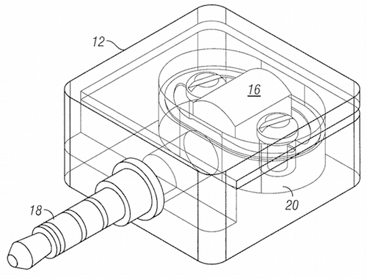



Patents
Must be “inventions” (Ex. processes, methods, manufacture, machines)
Must be: New, non-obvious & useful
Rights: for 20 yrs, exclusive right to exclude others from making, using, selling, offering for sale, or importing the invention into the US.
Hardest to obtain; most restrictive.
Have to file for patent with USPTO - Can be very expensive
Notes:
Cereal - Kellogg patented the Process of making cereal, can not patent the cereal itself
Monopoly - Patented the process or method of playing the game

Slide 20

Trade Secrets
Can be considered an “alternative” to a patent
Cheaper, perpetual, can be used when a patent is not applicable
Must be
  Secret or not generally known
  Reasonable measures taken to protect
  Disclosure would result in competitive gain
Examples: Customer lists, source codes, technical procedures, financial data, business plans, recipes

Slide 21





Trademarks
Commercially identify the source of your products - not just company names
  Product names (M&Ms), logos (Nike swoosh and Mcdonald's), sounds (MGM Studio’s lion roar), colors (Tiffany blue)
  Protects against consumer confusion of brand
  Product must be used in commerce
  Consider filing for trademark protection
    Use TM or SM if not registered
    Don’t use ® unless registered
  Can be Perpetual with continued use

Slide 22
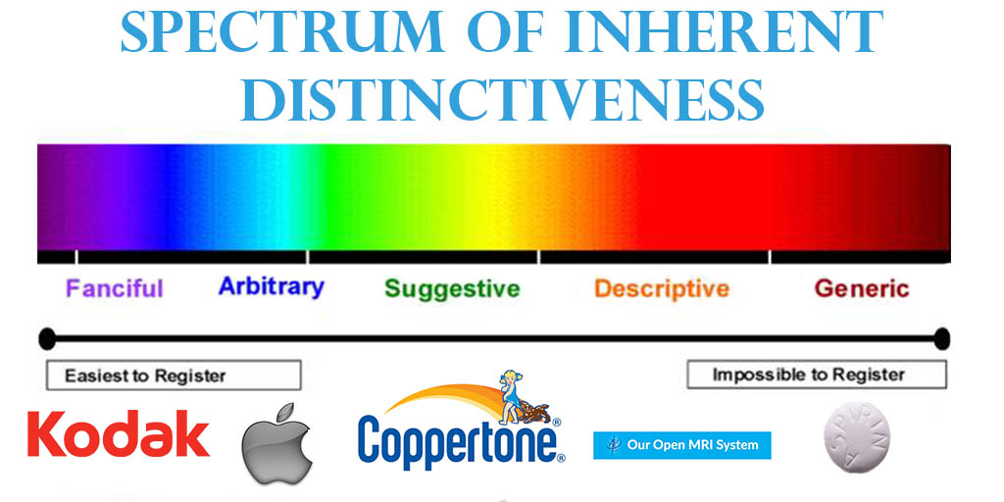
Notes:
Must not be generic or descriptive
“Tissue” vs. “Kleenex”
Never use your brand as a noun to keep this protection!
“Legal office” is descriptive
Kodak and Exxon are protectable, but only because of the purpose that they are talking about

Slide 23
Why Register?
Registration
Exclusivity
Basis for International filling
“Incontestability” (5 years)
Statutory Damages (x3)
®
Common Law
Can only establish use via actual and continued use
Geographic limits
™ only
Can only defend rights, not assert

Slide 24
How to File for Trademark Protection
Federal trademarks:
  Online initial search
  Unlimited duration
  Regular maintenance fees apply
Massachusetts trademarks:
  $50 fee per class (e.g., per type of good or service to which the trademark applies)
  Check with Secretary of Commonwealth before applying
  5 year duration (may be renewed)
  Application online

Slide 25
Copyright
  Right of an artist to control the copying, use, distribution, adaptation, display and performance of a work
    e.g., literature, art, choreography
  Protects the expression of ideas
    Not the idea itself
  Extends beyond life
  Formalities:
    Copyright notice (e.g., © 1999 Jane Smith)
    Registering with US Copyright Office may be advisable
  Basic filing fee - $35 online or $50 paper
  http://www.copyright.gov/

Slide 26
Small Group Activity 3:
Work with your group to discuss what, if any, intellectual property your company would own, and what, if any, steps you would take to protect it.

Slide 27
Contracts

Slide 28
What is a Contract?
An agreement between two or more parties that is legally enforceable
Can be written OR oral
Must involve a “bargained for exchange” (consideration) to be legally enforceable

Slide 29
Written Contracts
Some contracts have to be written
  Sales of goods over $500
  Leases with payments over $1,000
If you are writing a contract, make sure all the terms are written there, do not rely on oral terms

Slide 30
Example Terms and Conditions
Terms: How long is the agreement in effect? Can it be terminated early?
Price and how payment will be made
Time of performance
Procedures for waivers and amendments
Governing law
Integration clause (this is the final agreement)

Slide 31
Employment Contracts
Offer Letters
  Title, duties, salary, and benefits
  “At will” relationship - either party can end the relationship at any time
Nondisclosure, non-compete, etc.
  Agreements to protect business’ confidential information, trade secrets, and work product

Slide 32
Non-Disclosure Agreements (NDA’s)
Where your business involves a “trade secret” or other confidential information, consider a non-disclosure agreement with potential vendors, suppliers and other service providers that will have access to your confidential information
Facilitates exchange of information among the parties
Make sure that the definition of “confidential information” is very broad and the use of the information is limited in evaluating a new business relationship

Slide 33
Form Contracts
Consider having a form contract
Look at samples from your industry
Look for:
  Length - make sure it is short and simple
  Clearly spelled out pricing, when payment is due, and penalties or interest in the result of non payment
  Limitations on your liability if expectations not met
  “Force majeure” - relieving you from breach if unforeseen events occur
  Clause on how disputes will be resolved

Slide 34
Commercial Leases
Not like residential leases - the landlords do not have the same level of responsibility
Having a written lease is vital, otherwise rights are very limited
Basic Terms:
  Landlord (Lessor) and Tenant (Lessee)
  Description of the property being leased
  Rent
    Base Rent -What you pay each month
    Common area Maintenance Charges
      Management fees, maintenance expenses for the building and grounds, and utilities of the building
  Term: How long is the lease for?
    Tip: Agree on rent of formula to calculate rent for extended terms, generally better for tenant to have shorter term with more extension rights

Slide 35
Commercial Leases (other issues)
Does the lease permit your planned use?
  Tenants should try and make the “use” provision as broad as possible to allow for flexibility
  Often tenants are required to obtain landlord permission for a change of use, so want to make it as flexible as possible
Assignment and subletting - restrictions and limitations: Tenant should seek the ability to sublet without Landlord’s consent
  Where Landlord’s consent is required, make sure that it cannot be unreasonably withheld.

Slide 36
Small Group Activity 4:
Work with your group to discuss what, if any, contracts the business should have

Slide 37
Employment Law

Slide 38
Employees vs. Independent Contractors
Employees
Services at your direction
Company must pay benefits
Company must withhold taxes and provide a W-2
Independent Contractor
Company controls the result of the work, but not the means or method
Company provides a 1099, not a W-2
No withholdings from paycheck

Slide 39

Dangers of Misclassification
Misclassifying employees under any of the laws can subject a business to:
Income tax liability for money that should have been withheld
Employer FICA and FUTA contributions
Overtime and other wage claim liability
State unemployment Insurance payments
Workers Comp Insurance premiums and liability for workplace injuries
Benefits under existing employee benefit plans
Civil and Criminal penalties

Slide 40
Unpaid Interns
Generally: A company must compensate any worker who performs services for the business
Limited exception: Certain training programs in charitable, educational, or religious institutions.
Applies to both for-profit and non-profit companies
Notes:
6 Factors
The internship is similar to training offered in an education environment;
The internship experience is for the benefit of the intern;
The intern does not displace regular employees, but works under close supervision of existing staff;
The employer derives no immediate advantage from the activities of the intern (its operations may even be occasionally impeded);
There is no permanent position attached to the internship position; and
The employer and intern understand that the intern is not entitled to wages for the time spent in the internship.

Slide 41
Employment Applications
Not required
But, if used there are requirements:
  If asking about work history, must state that applicant can include verifiable volunteer work
  Do not ask about race, national origin, color, gender, sexual orientation, gender identity, ancestry, religion or age
    Age exception: May inquire whether applicant is under 18
Prospective employer cannot ask about employee’s criminal history on initial written application form
  Exceptions: (1) federal or state law disqualifies applicant based on conviction; (2) employer has legal obligation not to employ persons who have a conviction

Slide 42
“Ban the Box” - Job Applications
Prospective employer cannot ask about employee’s criminal history on initial job application
  Exceptions: (1) federal or state law disqualifies applicant based on convictions ; (2) employer has legal obligation not to employ persons who have a conviction.
Employer may make decisions based on the applicant’s criminal history, but must use source other than the initial job application
  For example, you can obtain criminal background checks on applicants who have received conditional offers of employment

Slide 43
Discrimination
Cannot refuse to hire someone because of race, color, religion, national origin, sex (including pregnancy), ancestry, gender identity, sexual orientation, age (40 or older), genetic information or military service
Cannot discriminate against qualified individual with disability who is capable of performing essential function of the job with or without reasonable accommodation, unless accommodation would impose “undue hardship”
BE CAREFUL WITH INTERVIEW QUESTIONS
Sexual Harassment

Slide 44
MA Pay Equity Law
An Act to Establish Pay Equity, Effective July 1, 2018. Employers may not ask about wage or salary history until after an offer of employment with compensation has been made
Prohibits inquiry during interview about prior wages or salary history.
Further, employers are prohibited from seeking applicants’ salary history from their current or former employers.
Caveat: Prospective employees may authorize a prospective employer to verify salary history, but only after receiving a job offer that includes compensation.

Slide 45
Immigration Issues
Must verify and document that employees are legally authorized to work in the U.S.
Must maintain I-9 forms
  Completed I-9 forms are kept on file, not filed with any government agency
  Federal government conducts I-9 audits

Slide 46
Paying your Employees
Minimum Wage: $12 in 2019 (will go up progressively every year)
Cannot defer payment, even with employees permission
For most hourly and salaried employees:
  IF work more than 40 hours/week, THEN paid 1.5 times regular hourly rate
  EXCEPTIONS: Restaurants, hotels, hospitals, nursing homes, gas stations, drivers/helpers on truck
Deductions:
  Required: State and federal income tax, Social Security, Medicare
  Employee authorized: health insurance, pension, savings plan, etc.

Slide 47
Benefits
Workers Compensation
  Participation required by all employers
  Exception: A corporate officer who owns at least 25% interest may exempt themselves
All employers required to participate in state unemployment compensation system
  Must register with state, make quarterly filings and payments
Other benefits at employer’s discretion, but once established there can be further legal restrictions
Must allow employees to accrue and use up to 40 hours of sick time per year

Slide 48
Small Group Activity 5:
Work with your group to discuss how your business will structure their hiring process, when hiring will take place, and what issues you will want to consult with an attorney about.

Slide 49
Small Group Presentations

