Slide 1
Bookkeeping & Forecasting
Mini Exercises

Slide 2
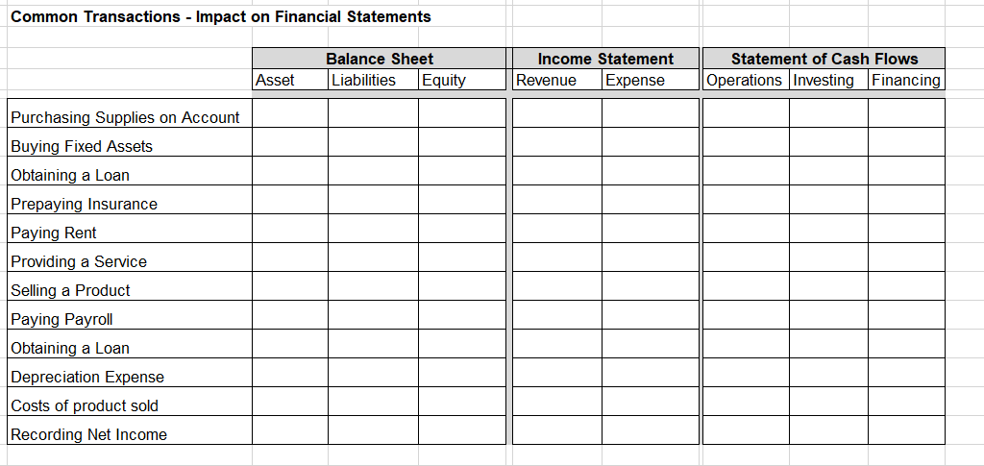
Common Transactions

Slide 3
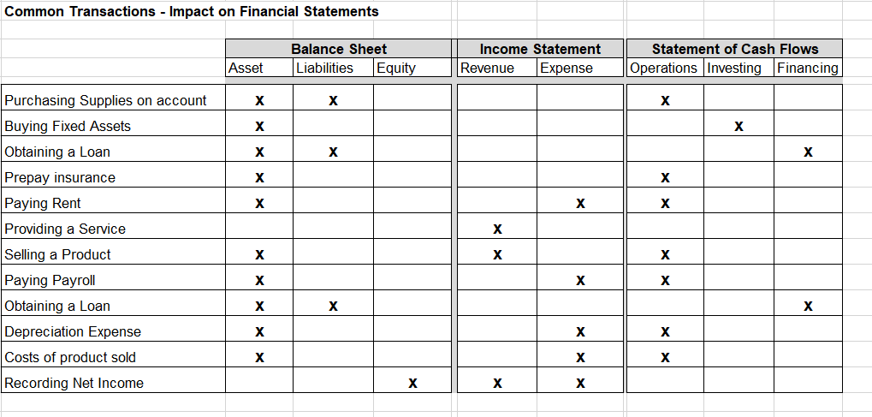
Common Transactions (Model Answer)

Slide 4
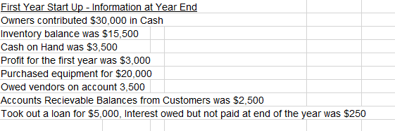
Balance Sheet for a Start Up (1/2)

Slide 5
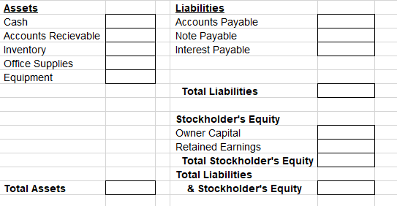
Balance Sheet for a Start Up (2/2)

Slide 6
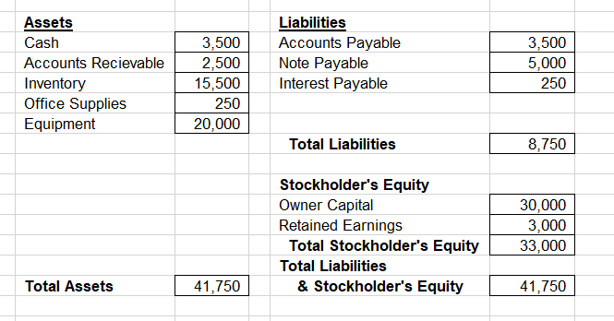
Balance Sheet for a Start Up (Model Answer)

Slide 7
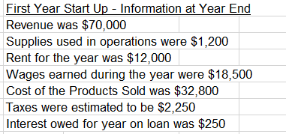
Income Statement for a Startup (1/2)

Slide 8
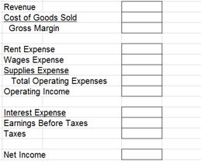
Income Statement for a Startup (2/2)

Slide 9
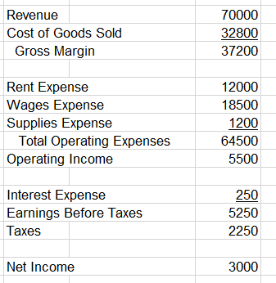
Income Statement for a Startup(Model Answer)

Slide 10
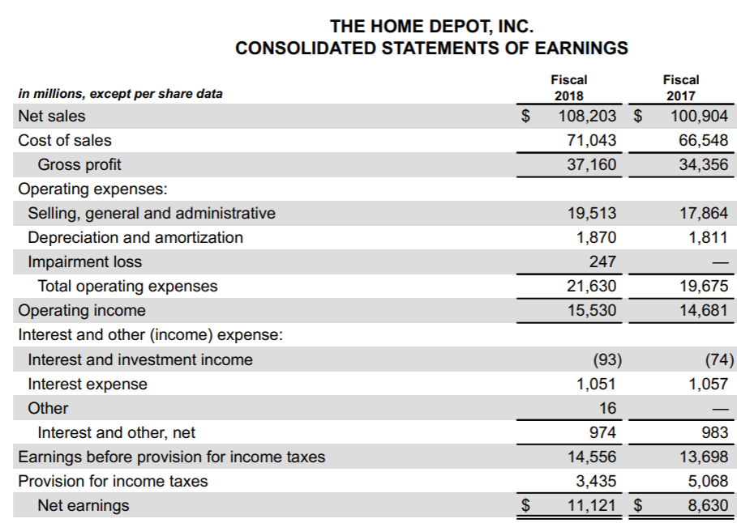
Gross Profit & Operating Margin (1/2))

Slide 11
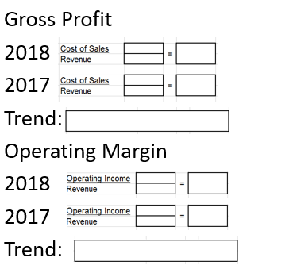
Gross Profit & Operating Margin (2/2)

Slide 12
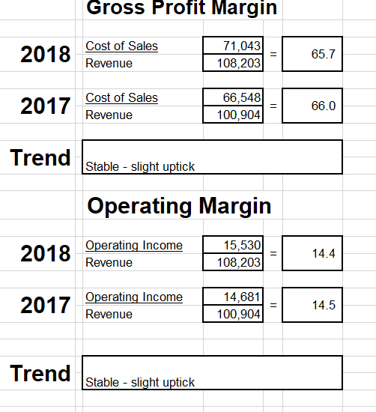
Gross Profit & Operating Margin(Model Answer)

Slide 13
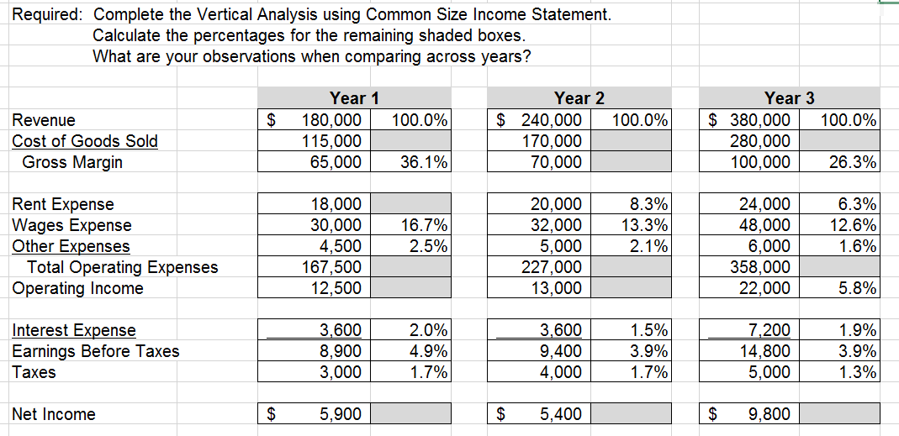
Vertical Analysis

Slide 14
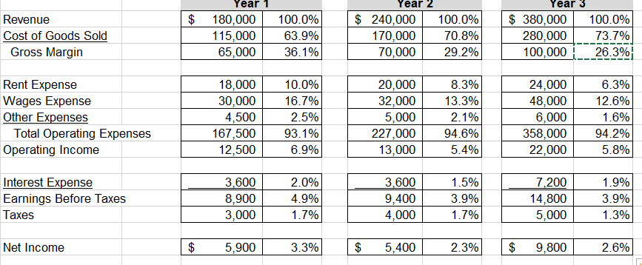
Vertical Analysis (Model Answer)

Slide 15
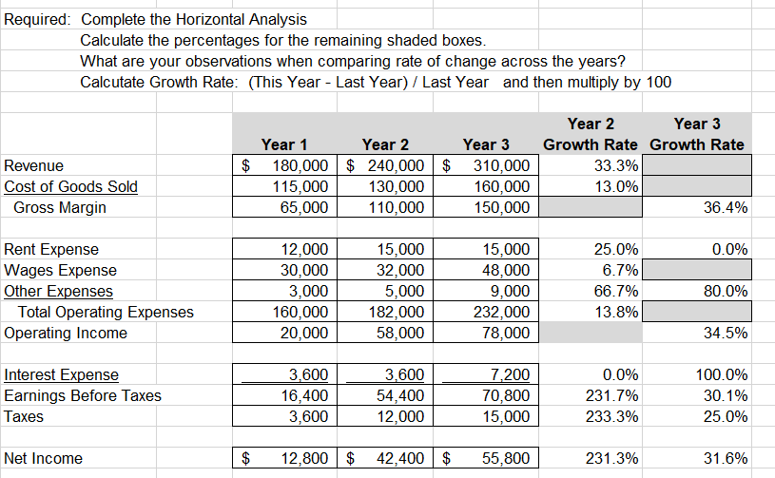
Horizontal Analysis

Slide 16
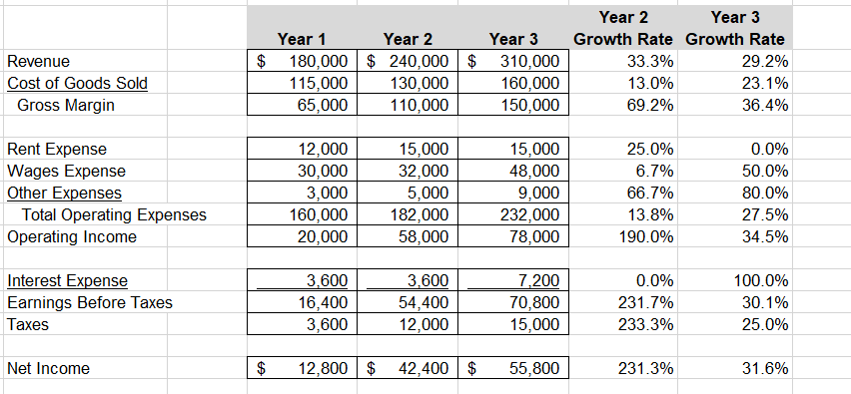
Horizontal Analysis Model Answer

Slide 17
Analysis Ratio & Trends
Scenario | Questions to ask, trend, ratio, or metric result
Revenue Growth Rate – calculate revenue growth rate from previous quarter for two scenarios a.) Revenue in Q1 was 24,000, in Q2 is 30,000 b.) Revenue in Q1 was 24,000, in Q2 is 18,000
Gross Profit Margin (Revenue – COGS / Revenue) a.) Cost of Sales in Q1 was 18,000, in Q2 was 26,000 b.) Cost of Sales in Q1 was 18,000, in Q2 was 12,000
Inventory Turnover (cost of sales/inventory) a.) Average Inventory: Q1 - 12,000, in Q2 - 18,000 b.) Average Inventory: Q1 – 12,000, in Q2 – 14,000
Cash Ratio (Cash/Current Liabilities a.) End of Q2 Balances: Cash 20,000 Current Liabilities 8,000 b.) End of Q2 Balances: Cash 8,000 Current Liabilities 15,000

Slide 18
Analysis Ratio & Trends (model answer)
Scenario | Questions to ask, trend, ratio, or metric result
Revenue Growth Rate – calculate revenue growth rate from previous quarter for two scenarios a.) Revenue in Q1 was 24,000, in Q2 is 30,000 b.) Revenue in Q1 was 24,000, in Q2 is 18,000 | Revenue Growth Rate a.) (30-24)/24 = 25% increase b.) (18-24)/24 = 25% decrease
Gross Profit Margin (Revenue – COGS / Revenue) a.) Cost of Sales in Q1 was 18,000, in Q2 was 26,000 b.) Cost of Sales in Q1 was 18,000, in Q2 was 12,000 | Gross Profit Margin a.) (24-18)/24 = 25%; (30-26)/30 = 13% decreasing b.) (24-18)/24 = 25%; (18-12)/18 = 33% increasing
Inventory Turnover (cost of sales/inventory) a.) Average Inventory: Q1 - 12,000, in Q2 - 18,000 b.) Average Inventory: Q1 – 12,000, in Q2 – 14,000 | Inventory Turnover a.) 18/12 = 1.5X; 26/18 = 1.4X b.) 18/12 = 1.5X; 12/14 = 0.9X
Cash Ratio (Cash/Current Liabilities a.) End of Q2 Balances: Cash 20,000 Current Liabilities 8,000 b.) End of Q2 Balances: Cash 8,000 Current Liabilities 15,000 | Cash Ratio a.) 20/8 = 2.5 b.) 8/15 = 0.5

Slide 19
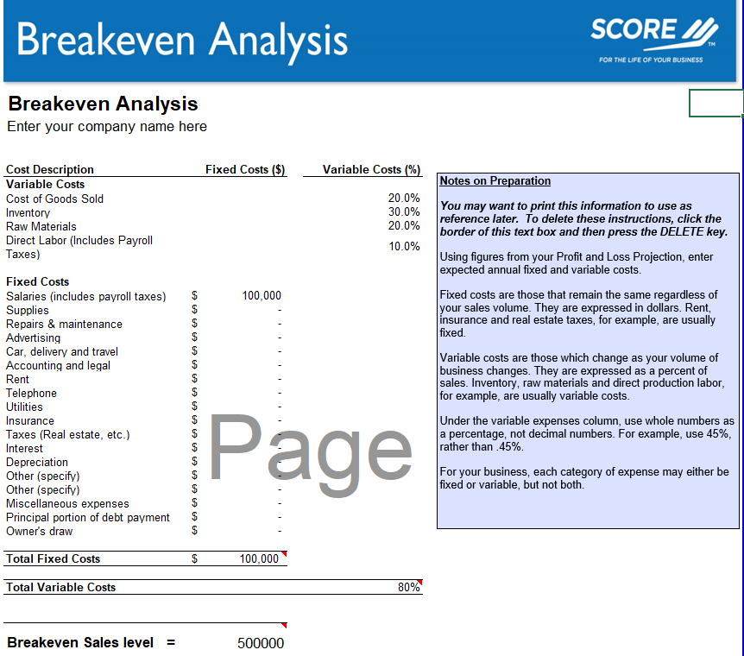
Hour 6: Breakeven Analysis https://www.score.org/resource/break-even-analysis-template

